Slide 1
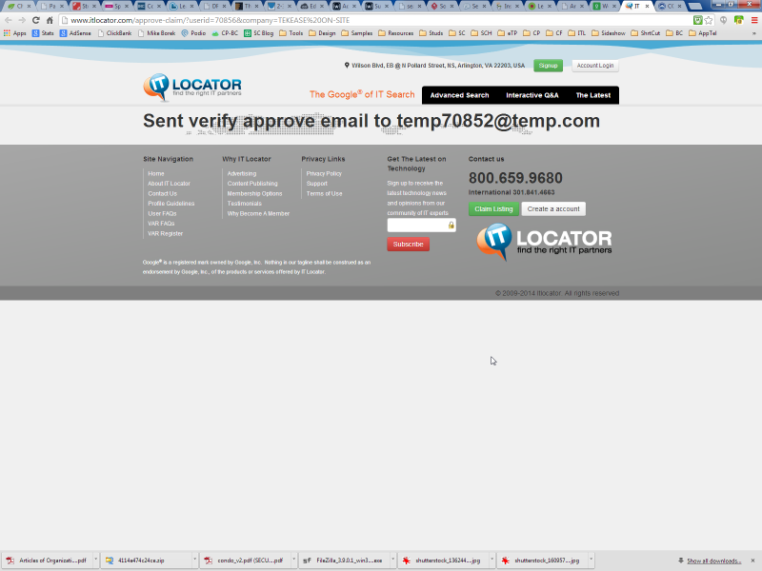
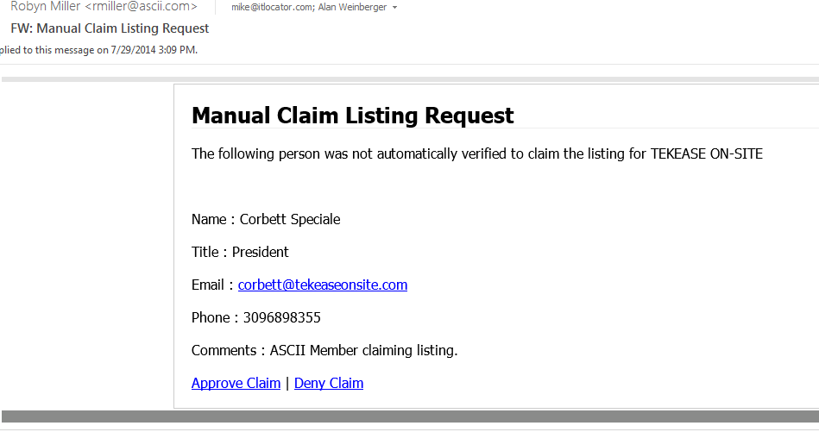
The approve email should be sent to user entered email…not sure what this temp.com email is. It needs to be replaced with email user entered!

